Slide 1

EDI Hub+ Flexible Fund: Information Webinar (4 March 2026)
To activate closed captions: 1) In the meeting controls
at the top of the screen, select ‘More’ (the three dots).
2) Go to ‘Language and speech’ and select ‘Show live captions’.
Q&A: There will be a specific Q&A section after the presentation. Please use the Q&A function to share questions with the speaker. Questions will not be visible to the audience, only to the speaker and host. Questions can be submitted with your name or anonymously. Any questions not addressed during the session will be circulated with answers after the webinar.
Code of conduct: We are dedicated to providing a harassment-free experience for everyone. We do not tolerate harassment of event participants in any form. Abusive language or imagery is not appropriate in any of our events, and any participants violating these rules may be expelled from EDI Hub+ events at the discretion of the event organisers.
www.edihubplus.ac.uk

Slide 2
EDI Hub+ Flexible Fund
Round 2 - Information Webinar
4 March 2026
Dr Lisa Hill
Flexible Fund Workstream Lead
www.edihubplus.ac.uk

Slide 3
EDI Hub+ Flexible Fund – Round 2 webinar
Agenda
EDI Hub+
Flexible Fund
Round 2 call
Reflections on Round 1
Q&A
www.edihubplus.ac.uk

Slide 4

EDI Hub+ Flexible Fund – Round 2 webinar
EDI Hub+ introduction
Our mission is to drive systemic change, to deliver an Engineering, Physical and Mathematical Sciences research and innovation system that is equitable and inclusive for everyone.
www.edihubplus.ac.uk

Slide 5
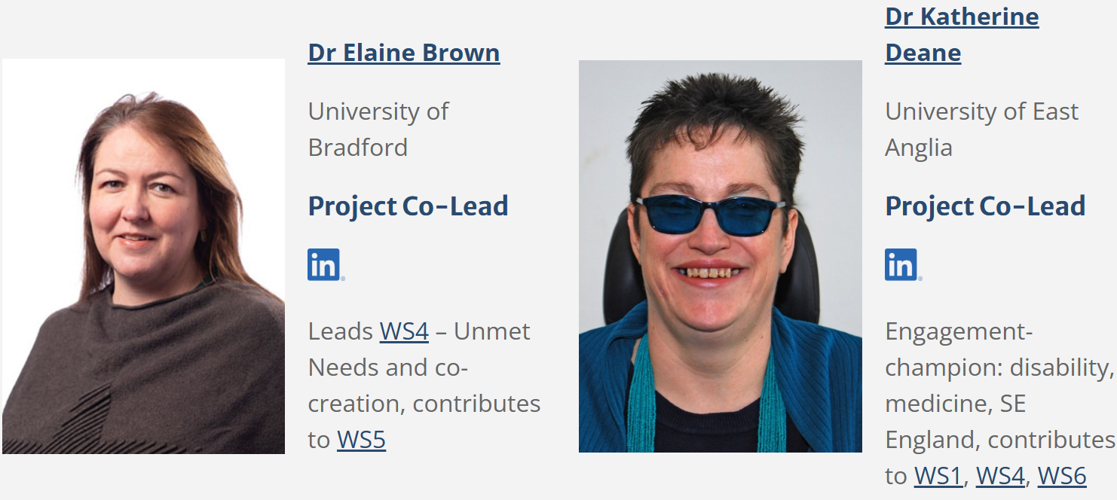
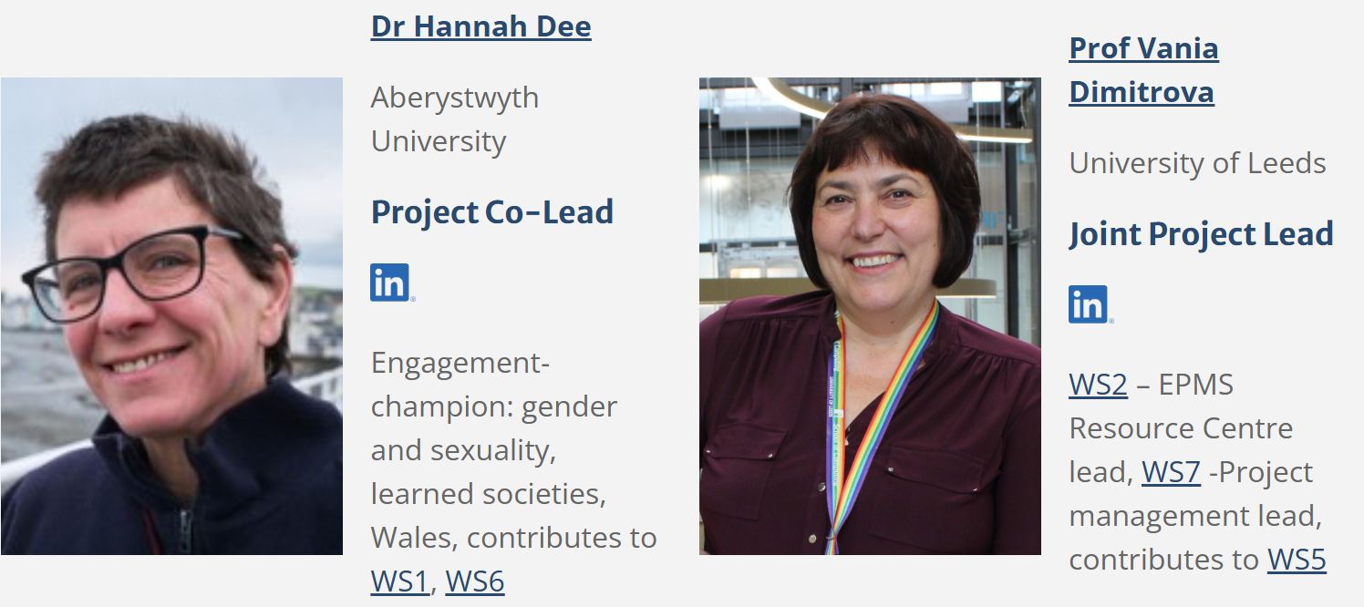
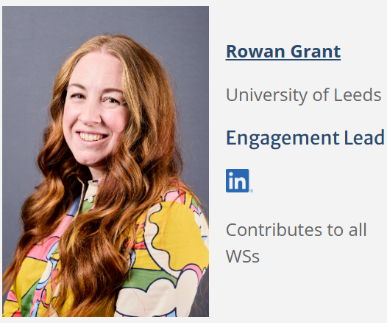
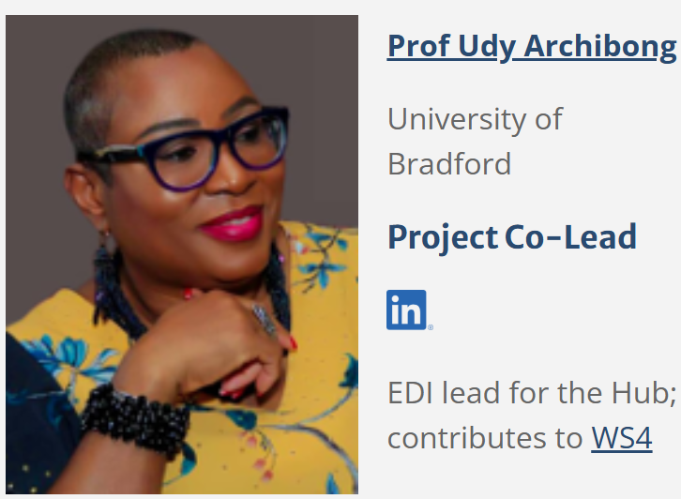
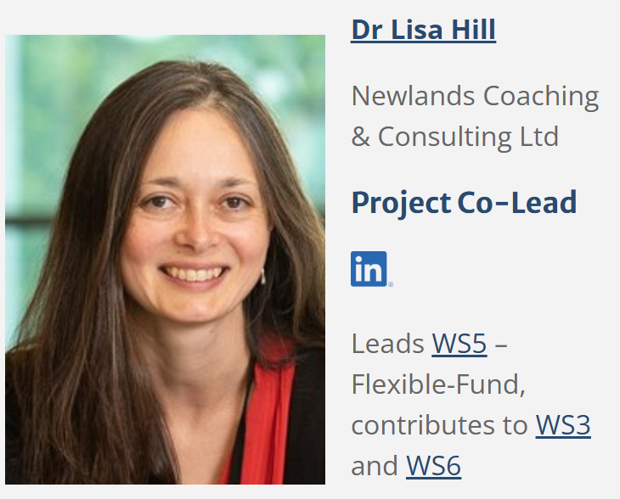
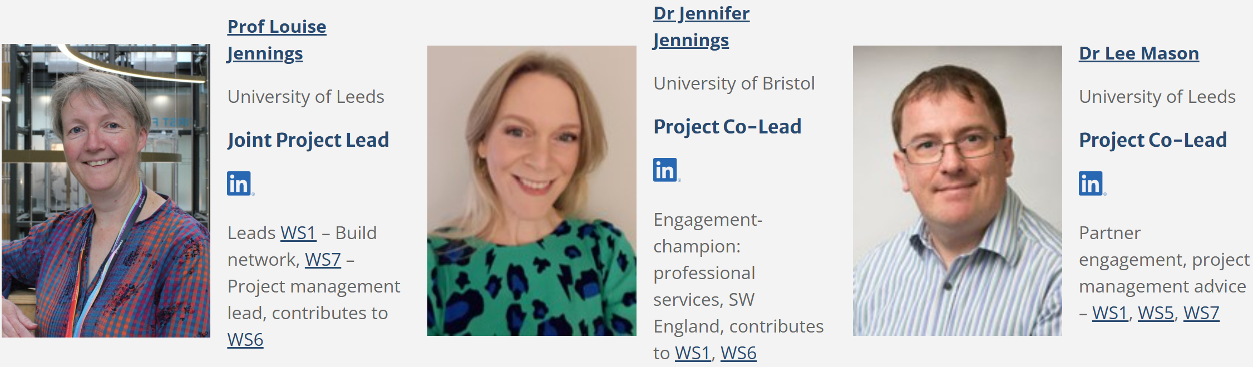
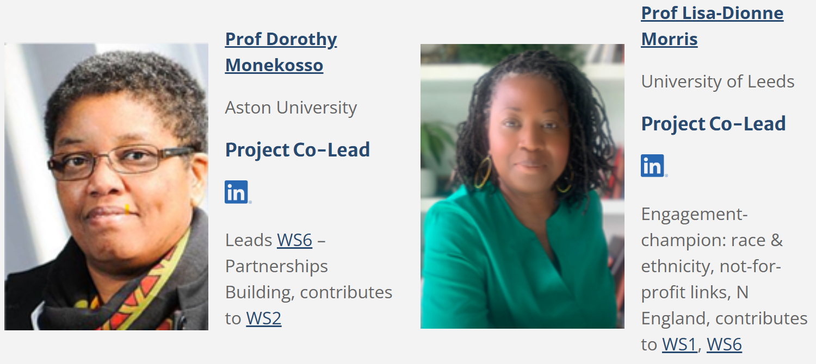
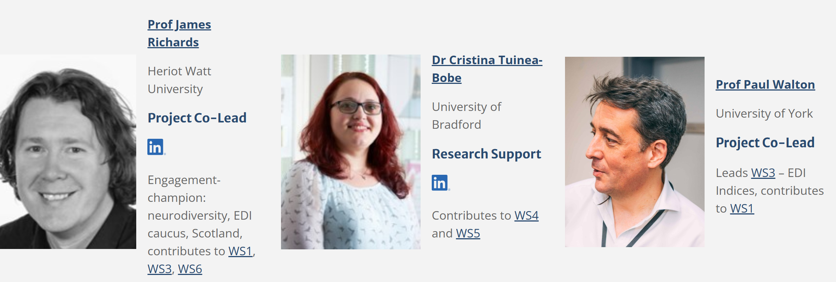
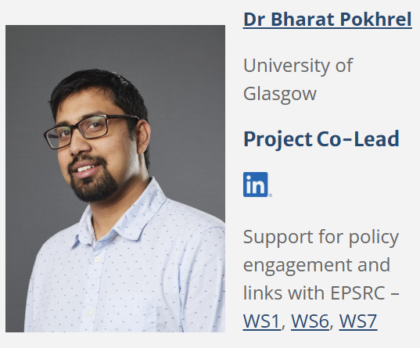
EDI Hub+ Core Team
EDI Hub+ Flexible Fund – Round 2 webinar

Slide 6
EDI Hub+ Workstreams
EDI Hub+ Flexible Fund – Round 2 webinar
WS1: Build a broad network
Sharing EDI Practices
Enabling Sustained Transformation
WS2: Create an interactive online resource Centre
WS3: Create, share, and utilise EDI indices
WS4: Identify unmet needs
WS5: Flexible fund
WS6: Facilitate widespread adoption
WS7: Project management and dissemination
www.edihubplus.ac.uk

Slide 7



EDI Hub+ Vision
EDI Hub+ Flexible Fund – Round 2 webinar
Pilot EDI interventions
Scale-up EDI interventions
Co-ordination at national level
Basic EDI not entering practice
Pilots not implemented at scale
Limited adoption at national level
Implementation in multiple settings
Needs identification
Small-scale pilot projects
Widespread adoption
Pilots in EPMS Research and innovation context
Pilots evaluated at scale in multiple EPMS Research and innovation contexts (regions, institutions user groups)
Widespread adoption across regions, institutions, disciplines; embedding EDI in EPMS research and innovation
Feasibility studies
EDI intervention readiness level
Engaging with the community to identify and share good practice, determine unmet needs,
and progress successful EDI interventions and initiatives on the journey towards
widespread implementation and adoption.

Slide 8
EDI Hub+ Flexible Fund – Round 2 webinar
Flexible fund – overview
~£1M
Three rounds – one each year: Spring 2025, 2026, 2027
EPSRC eligibility and funding rules
Awards made at 80% costs, excluding estates and indirects
Emphasis on lived experience, co-design, and evaluation
www.edihubplus.ac.uk

Slide 9
EDI Hub+ Flexible Fund – Round 2 webinar
Flexible fund – aims and themes
The Flexible Fund aims to support the implementation, evaluation, and scale-up of EDI interventions and initiatives in the Engineering, Physical and Mathematical Sciences research and innovation system across three themes:
Career Pathways
Research Funding and Processes
Organisational Culture
www.edihubplus.ac.uk

Slide 10
EDI Hub+ Flexible Fund – Round 2 webinar
1. Career Pathways: We welcome proposals that focus on one or multiple aspects of career pathways.
Growing diverse leadership in research and innovation.
Attracting and retaining diverse doctoral students, and removing barriers to doctoral study for underrepresented groups.
Making the transition to an academic career attractive and open to everyone.
Providing support at key career transitions to address the ‘leaky pipeline’.
Making broader research and innovation roles (e.g., Research Technical Professionals, Research Software Engineers) more attractive and empowering.
Supporting cross-sectoral transitions (e.g., into / out of academia and industry).
www.edihubplus.ac.uk

Slide 11
EDI Hub+ Flexible Fund – Round 2 webinar
2. Research Funding and Processes: We welcome proposals that focus on one or multiple aspects of the funding process.
Inclusive pre-submission selection practices and demand management in academic institutions.
Reducing the burden for specific groups, such as disabled people, those with caring responsibilities.
Inclusive practice within EPSRC investments (i.e., EPSRC grants operating their own flexible fund).
Trialling and evaluating alternative approaches to a) calls for proposals, b) application processes, and c) the assessment of applications, including alternative approaches to peer review.
www.edihubplus.ac.uk

Slide 12
EDI Hub+ Flexible Fund – Round 2 webinar
3. Organisational Culture: We welcome proposals that focus on one or multiple aspects of organisational culture and space.
Making our physical and virtual workspaces inclusive and accessible – with specific emphasis on research labs.
Challenging harassment and micro-aggression, becoming active bystanders.
Adopting equitable work-life balance approaches, supporting ‘family-friendly’ or ‘care-friendly’ policies and practices.
Ensuring everyone’s participation in the research and innovation system is fully recognised.
www.edihubplus.ac.uk

Slide 13
EDI Hub+ Flexible Fund – Round 2 webinar
What is not in scope?
X Teaching and learning
X Widening participation at undergraduate level
X Public Engagement
www.edihubplus.ac.uk

Slide 14
EDI Hub+ Flexible Fund – Round 2 webinar
Flexible fund – types of project
The Flexible Fund will support three different types of project:
Pilot Projects
Evaluation Projects
Scale-up Projects
www.edihubplus.ac.uk

Slide 15
EDI Hub+ Flexible Fund – Round 2 webinar
Pilot projects (1)
Aim to support the initial implementation of EDI initiatives and interventions.
Pilot projects should address a specific, unmet EDI need or challenge facing the Engineering, Physical and Mathematical Sciences community.
For Round 2, pilot projects must address one of our two highlight areas:
Actions to identify and address the impact of socioeconomic disadvantage on doctoral education and wider career paths.
Precarity in EPMS research and innovation careers, including professional services staff in fixed-term roles, their retention, progression, and recognition.
www.edihubplus.ac.uk

Slide 16
EDI Hub+ Flexible Fund – Round 2 webinar
Pilot projects (2)
Applicants must provide an evaluation plan setting out how they will collect, collate, and curate evidence to evaluate success.
Funding available: up to £50K (80% direct costs) per project
Duration: up to 12 months
We expect to fund a maximum of two pilot projects per round.
www.edihubplus.ac.uk

Slide 17
EDI Hub+ Flexible Fund – Round 2 webinar
2. Evaluation projects (1)
Aim to evaluate existing EDI interventions and initiatives that have not been thoroughly evaluated.
Funding can be used to develop evaluation frameworks, collect data, and/or analyse existing data.
Funding can be used to support participatory design and co-creation to develop evaluation frameworks, the implementation of established tools and techniques, or engagement with independent evaluation experts.
www.edihubplus.ac.uk

Slide 18
EDI Hub+ Flexible Fund – Round 2 webinar
2. Evaluation projects (2)
Applicants must provide a logic model, setting out the project’s activities and its intended effects.
Applicants will need to demonstrate a robust and considered approach to evaluation, which aims to identify both what has worked and what has not worked.
Funding available: up to £30K (80% direct costs) per project
Duration: up to 12 months
We expect to fund a maximum of three evaluation projects per round.
www.edihubplus.ac.uk

Slide 19
EDI Hub+ Flexible Fund – Round 2 webinar
3. Scale-up projects (1)
Aim to scale up existing EDI interventions and initiatives that have proved effective in one or more settings, e.g., a discipline, an institution, a doctoral training award, or a research project. The first step in this process will be to scale up your activities across multiple settings.
Where needed, we will provide advice and partnership-building support. Contact us at EDIHubPlus@leeds.ac.uk
Scale-up projects will need to address one or more specific EDI challenges or needs facing the Engineering, Physical and Mathematical Sciences community.
www.edihubplus.ac.uk

Slide 20
EDI Hub+ Flexible Fund – Round 2 webinar
3. Scale-up projects (2)
Applicants must provide:
evaluation evidence to demonstrate the success of their intervention or initiative,
a comprehensive plan to explain how they will scale up their activities,
a logic model and a robust evaluation plan setting out how they will collect, collate, and curate evidence to evaluate success, including what has and has not worked.
Funding available: up to £80K (80% direct costs) per project
Duration: up to 12 months
We expect to fund a maximum of three scale-up projects per round.
www.edihubplus.ac.uk

Slide 21
EDI Hub+ Flexible Fund – Round 2 webinar
Access fund
An additional, separate fund has been allocated for project teams requiring accessibility support.
Successful projects can apply for this additional support.
www.edihubplus.ac.uk

Slide 22
EDI Hub+ Flexible Fund – Round 2 webinar
Who can apply?
We are following EPSRC’s standard organisational eligibility rules.
In addition to the EPSRC’s standard eligibility rules for individuals, we have widened the eligibility for project leads and project co-leads to support different career paths within the research and innovation community.
We have adopted a flexible leadership model that allows for up to two project leads. Allowing more than one project lead enables the leadership to be performed as a job share.
www.edihubplus.ac.uk

Slide 23
EDI Hub+ Flexible Fund – Round 2 webinar
Round 2 Timeline
Pre-announcement | 2 February 2026
Call goes live, webinar | 4 March 2026
Closing date | 24 June 2026
Peer review | summer / autumn 2026
Opportunity Review Panel meeting | Autumn 2026
Projects start by | 1 April 2027
www.edihubplus.ac.uk

Slide 24
EDI Hub+ Flexible Fund – Round 2 webinar
Round 2 Assessment criteria:
1. The degree to which proposals will create impact, e.g., improving working lives for people across the research and innovation ecosystem.
2. The degree to which proposals engage with, or are led by, those with lived experience of marginalisation in the Engineering, Physical and Mathematical Sciences research and innovation space.
3. The degree to which proposals adopt a co-design approach, including how key stakeholders or research end users will be engaged in the project.
www.edihubplus.ac.uk

Slide 25
EDI Hub+ Flexible Fund – Round 2 webinar
4. The quality of the EDI Plan, including the degree to which EDI considerations have been embedded in all aspects of the project.
5. The quality of the Evaluation Plan, and the degree to which proposals demonstrate a robust and considered approach to evaluation.
www.edihubplus.ac.uk

Slide 26
EDI Hub+ Flexible Fund – Round 2 webinar
Pilot Projects only:
6. The degree to which proposals address an unmet EDI challenge or need in the Engineering, Physical and Mathematical Sciences research and innovation space.
Scale-up Projects only:
7. The degree to which proposals can demonstrate that the EDI intervention or initiative they plan to scale-up has proven effective in one or more settings. Evidence must be provided.
8. The degree to which proposals set out a comprehensive plan that explains how they will scale up their activities.
www.edihubplus.ac.uk

Slide 27
EDI Hub+ Flexible Fund – Round 2 webinar
How to apply
Submit a completed application form via email by 4pm on Weds 24 June 2026 to edihubplus@leeds.ac.uk with the subject line ‘Flexible Fund Application Submission’.
Important: We are using different forms for each type of project (pilot, scale-up, evaluation). Please ensure you use the correct form.
www.edihubplus.ac.uk

Slide 28
EDI Hub+ Flexible Fund – Round 2 webinar
How to apply
Application information
Information about your team (max. 500 words)
Case for support (max. 1500 words)
Workplan (max. one page)
EDI plan (max. 500 words)
Evaluation plan (max. 500 words)
Research ethical considerations (max. 500 words)
A data management plan (max. 500 words)
A full breakdown of costs
A justification of resources (max. 500 words)
Letters of support (max. one page per letter)
Short EDI survey
www.edihubplus.ac.uk

Slide 29
EDI Hub+ Flexible Fund – Round 2 webinar
Eligible costs
Directly allocated staff costs
Directly incurred staff costs
Directly incurred travel, accommodation and subsistence
Directly incurred consumables, including equipment (under £10,000)
Directly incurred other costs, e.g., consultancy fees
Please note that estates and indirect costs are not eligible and must not be charged to the grant. Please also note that costs for or associated with doctoral research must not be charged to the grant.
www.edihubplus.ac.uk

Slide 30
EDI Hub+ Flexible Fund – Round 2 webinar
Review process
Round 2: Standard research council process
EDI Hub+ eligibility checks
Eligible applications assessed by at least two reviewers
Panel meeting to discuss and collectively rank applications in order of funding priority
All applicants will receive feedback
www.edihubplus.ac.uk

Slide 31
EDI Hub+ Flexible Fund – Round 2 webinar
Resubmissions
Can applicants to Round 1 can resubmit their application to Round 2?
Yes. We are not actively encouraging resubmissions, but applications can be resubmitted provided they fit with the scope of the Round 2 call and respond to reviewer feedback from Round 1. Please bear in mind that in Round 2 we will only be accepting Pilot Project applications that address one of the two highlight areas:
Actions to identify and address the impact of socioeconomic disadvantage on doctoral education and wider career paths.
Precarity in EPMS research and innovation careers.
www.edihubplus.ac.uk

Slide 32
EDI Hub+ Flexible Fund – Round 2 webinar
Reflections on Round 1: panel advice
Focus on EDI rather than other aspects of Research Culture
Ensure the focus of proposals is specific to EDI in EPMS
Be specific about project activities and justify costs
Include references to provide evidence
Ensure plans and methods for data gathering and analysis are rigorous
Remember that the focus of the EDI Hub+ is on evaluation and scale-up
www.edihubplus.ac.uk

Slide 33
EDI Hub+ Flexible Fund – Round 2 webinar
Outcomes from Round 1
49 applications received
Awards and success rates:
Pilot projects – one award – success rate 3%
Evaluation projects – one award – success rate 14%
Scale-up projects – three awards – success rate 23%
www.edihubplus.ac.uk

Slide 34
EDI Hub+ Flexible Fund – Round 2 webinar
Outcomes from Round 1: what we funded…
Navigating reasonable adjustments: Empowering neurodivergent PGRs through transparency and co-design (Pilot)
Lead: Dr Lauren Marsh, University of Nottingham Co-creating practical resources to help neurodivergent postgraduate researchers and supervisors navigate reasonable adjustment processes, including a “dictionary” of adjustments and induction materials.
The well chaired meeting (Evaluation)
Leads: Professor Averil Macdonald OBE and Aubree Slavik, University of Southampton Evaluating the impact of training chairs and participants in inclusive meeting practices on the experiences of women, minority groups, early career researchers, and neurodiverse colleagues. The project aims to identify effective strategies to ensure all voices are heard and valued.
www.edihubplus.ac.uk

Slide 35
EDI Hub+ Flexible Fund – Round 2 webinar
Outcomes from Round 1: what we funded…
Expanding the Roving Researcher Scheme to new disciplines at the University of Cambridge
Leads: Professor Laura Itzhaki and Paula Bibby, University of Cambridge Scaling up an initiative that provides skilled researchers to cover lab roles during extended leave, supporting research continuity and promoting sustainable career pathways.
The EDI STEM Training Hub: Cultivating inclusive workplaces through collaborative, STEM-specific online training
Lead: Dr Clare Stevenson, John Innes Centre Expanding bespoke EDI training into EPMS disciplines, with new modules on legal requirements, microaggressions, and active bystander guidance, tailored to STEM environments.
Research your way
Lead: Dr Kat Phillips, University of Warwick Scaling up PhDYourWay into ResearchYourWay to support career development across STEM disciplines, providing targeted resources, community-led sessions, and a permanent online hub.
www.edihubplus.ac.uk

Slide 36
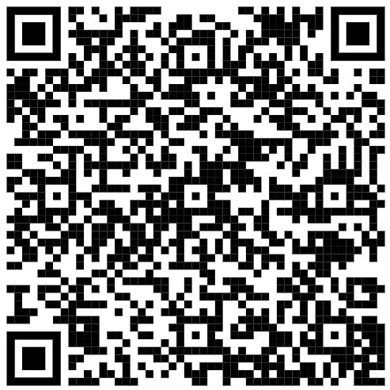
EDI Hub+ Flexible Fund – Round 2 webinar
Join our mailing list!
Email: EDIHubPlus@leeds.ac.uk
LinkedIn: https://www.linkedin.com/company/epsrc-edi-hub-plus
www.edihubplus.ac.uk

Slide 37
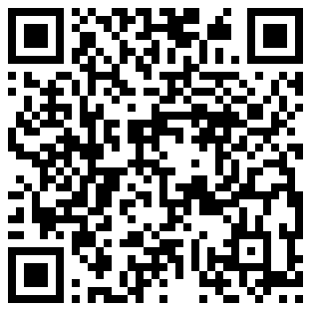
EDI Hub+ Flexible Fund – Round 2 webinar
Register for the EDI Hub+ Annual Conference
24 March 2026
(Leeds / hybrid)
https://edihubplus.ac.uk/event/edi-hub-annual-conference-shaping-the-future-of-research-through-inclusion/
www.edihubplus.ac.uk

Slide 38
EDI Hub+ Flexible Fund – Round 2 webinar
Q&A
Over to you!
www.edihubplus.ac.uk

